Slide 1
Discovering Prompt Engineering

Slide 2
Process of crafting precise and effective prompts

Slide 3
You are an experienced author for web texts. Your task is to create a blog post on
Books on beach holiday that is targeted towards families with school children.
It should be around 500 words with proper formatting. It should answer
the thought “Things to do with your family on a beach holiday”

Slide 4
You are an experienced author for web texts. Your task is to create a blog post on
Books on beach holiday that is targeted towards families with school children.
It should be around 500 words with proper formatting. It should answer
the thought “Things to do with your family on a beach holiday”
role — task — context — format — example/goal

Slide 5
cue: blog for books for a beach holiday
instructions/comments:
Write a 500-word blog post titled “Things to Do with Your Family on a Beach Holiday.”
You’re an experienced author who writes web-friendly, engaging text. The tone should be warm, conversational, and oriented toward families with school-age children. Include headings and short paragraphs so it reads easily online.
summary/additional info:
Audience: families planning a beach holiday with kids
Purpose: inspire ideas and activities beyond just swimming or sunbathing
Include: book suggestions, fun games, bonding ideas, and relaxation tips
Format: web-ready article (~500 words) with proper subheadings
Mention of files: none (no external edits needed)
cue — instructions/comments — summary/additional info

Slide 6
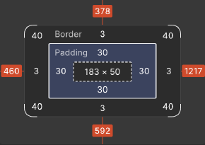
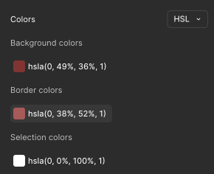
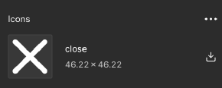
Button
cue: add a button // i want a button, that is:
instructions/comments:
width 184px, height 50px, padding 30px all around, border width 3px, border corner radius 40px, icon is 46.22px*46.22px, gap between icon and text is 20px. button text is “Button” and size is 42px, typeface is SF Pro Display Regular.
button bg color (0,49%, 36%, 1),
border color (0,38%, 52%, 1),
text and icon color (0,0%,100%,1)
summary/additional info:
colors are in HSLA, path for the icon: `public/icons/close.svg`.
for design system purposes create the following tokens: - (0,49%, 36%, 1): primary,
- (0,38%, 52%, 1): primary-tint-100
- (0,0%,100%,1): neutral-white

Slide 7
“AI is dumb without a human-in-loop”

Slide 8
prompt: make a mini piano, that works on my laptop and teaches me basics

Slide 9
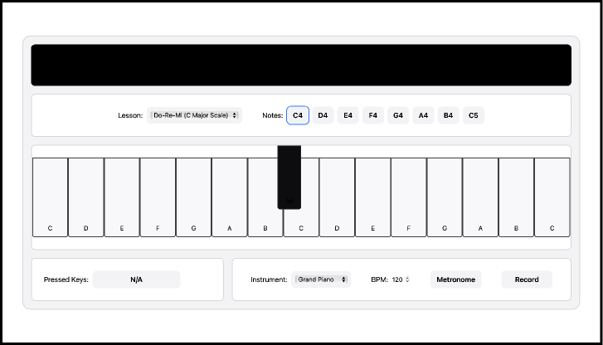
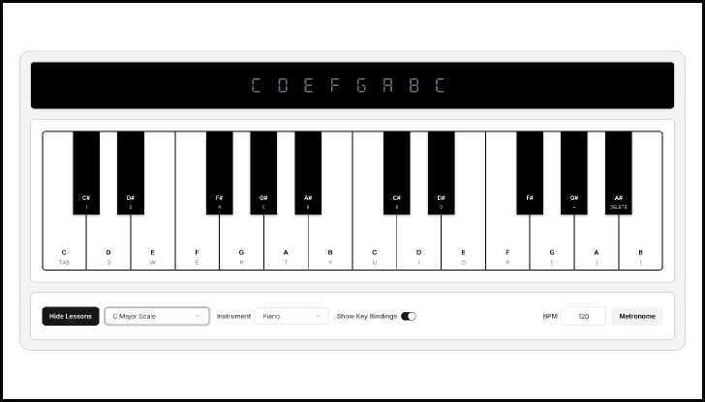
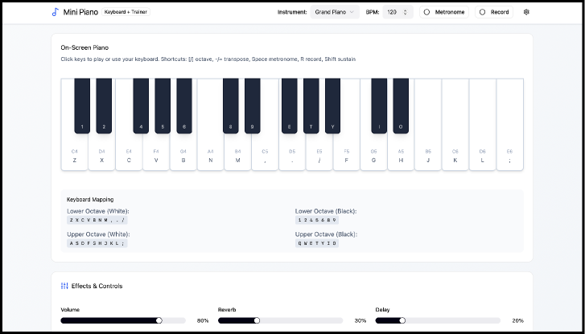
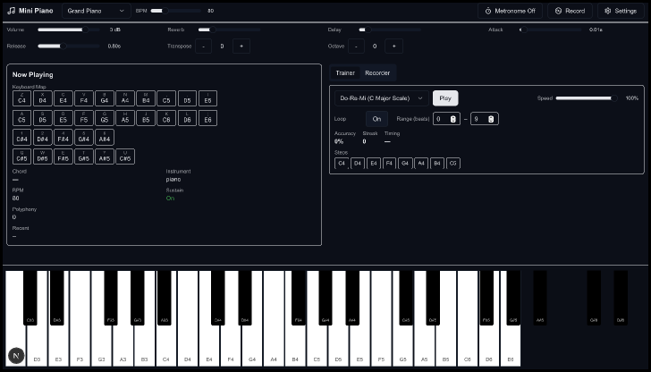

Slide 10
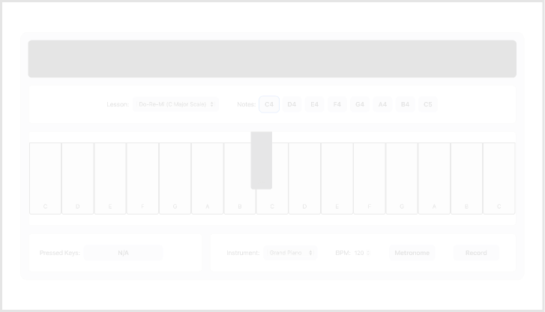
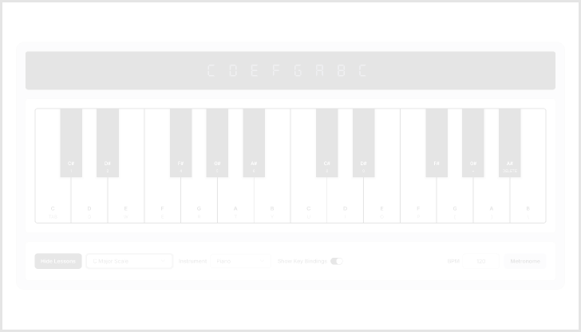



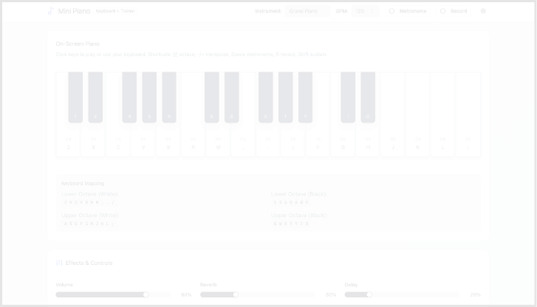
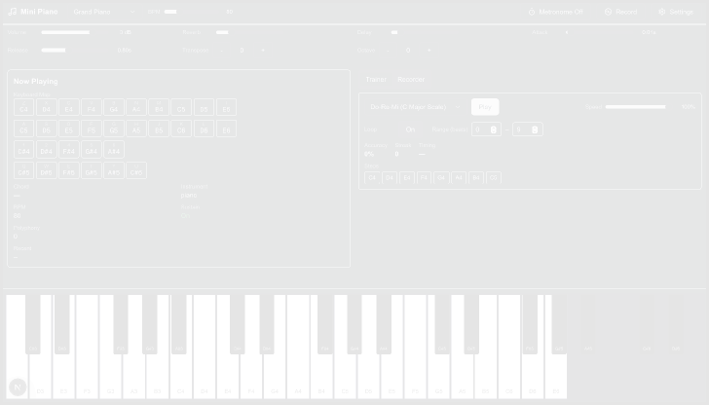

figma mcp + cursor
v0 + codex
figma make
codex

